Slide 1
Airbnb Application
Fatemeh Borhan

Slide 2
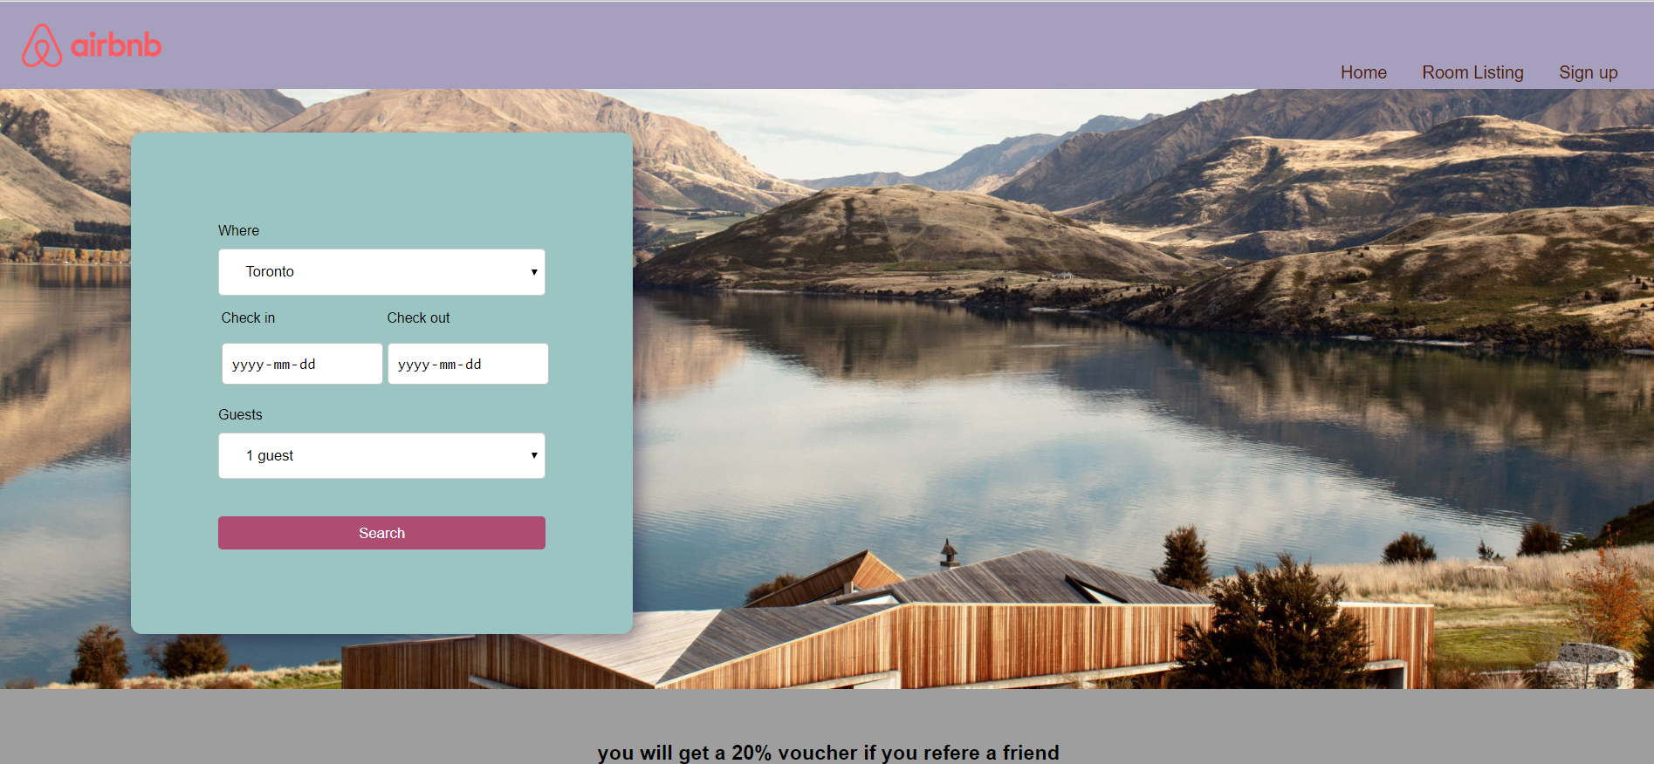
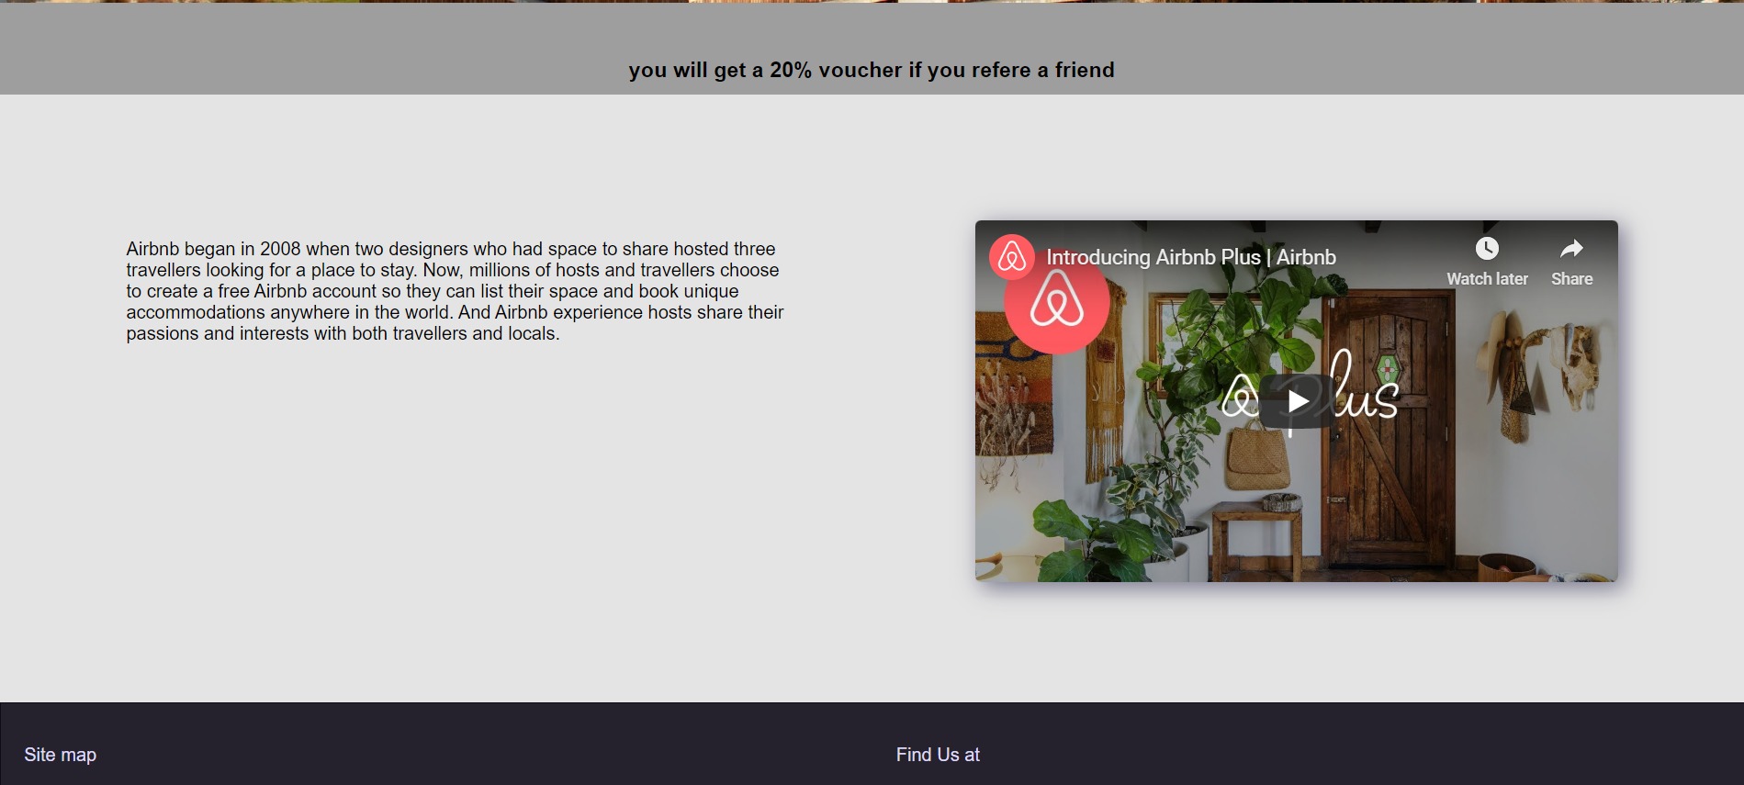
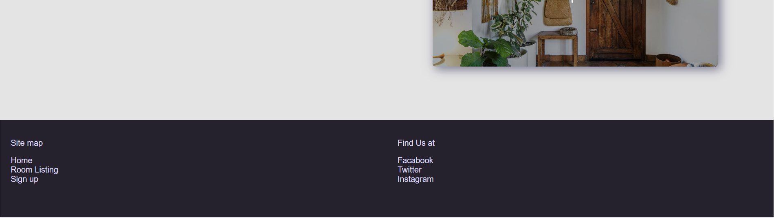
Home Page
It has header with a logo and the navigation bar including “home, room listing, and sign up”. All of them works properly and navigate us to the destinations.
The booking search form is created the same as the given sample, with all details and alignments. I used the date type for check-in and check-out dates.
Promotion and information sections are also created according to the instruction. A text paragraph and a video are placed in the information section.
The footer includes the sitemap and the social media links.

Slide 3
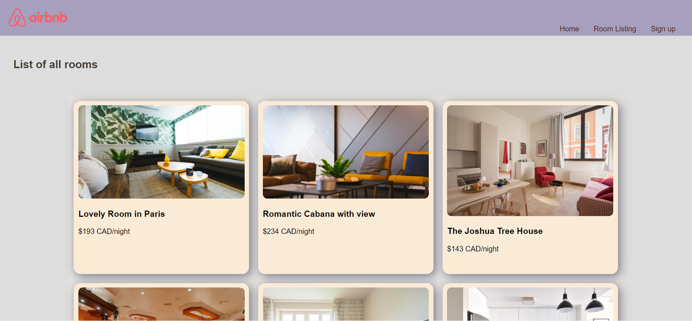
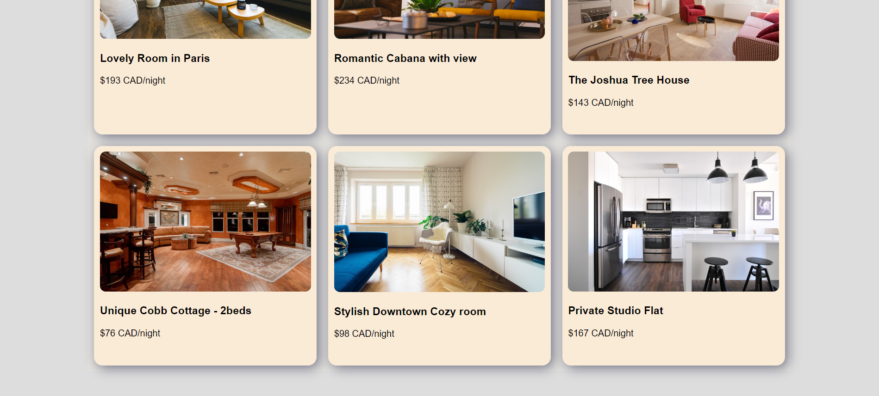
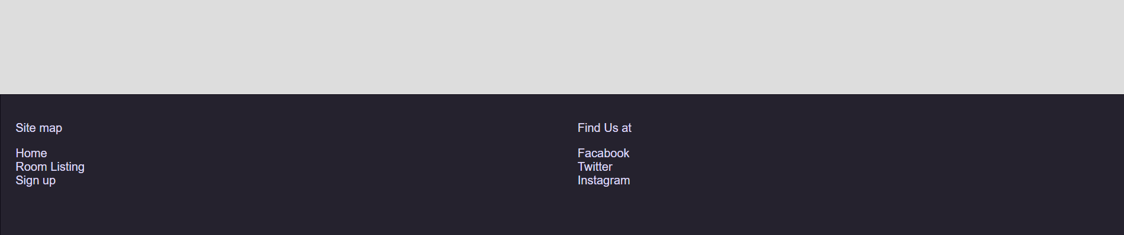
Room Listing Page
Room Listing page shows 6 blocks of rooms, and each block consists of a photo, a title and a price name.
The header, navigation and footer is created in the main handlebar, so are rendered the same in all our pages.

Slide 4
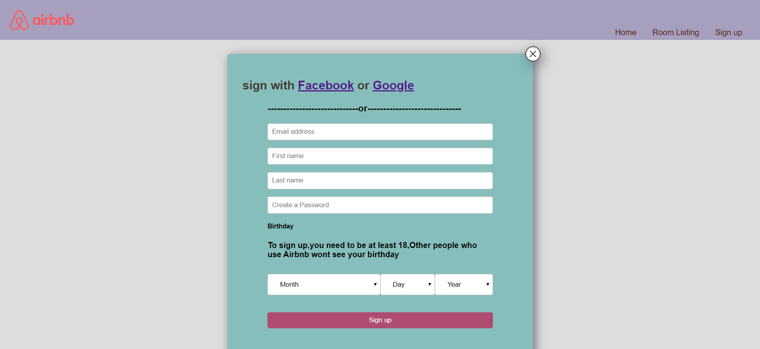

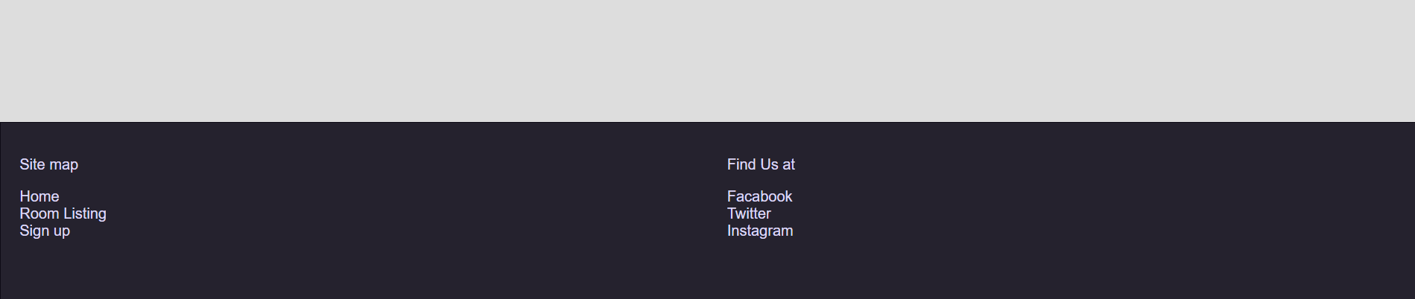
Registration Page
The registration form created exactly based on the sample image.

